Slide 1
Predicting NBA Player Salaries
Anderson, Taylor
Lawrence, Jonathan
Peterson, Jeffrey

Slide 2
Problem Statement
Background
The National Basketball Association (NBA) is a men’s professional basketball league comprised of 30 teams.
Hypothesis
The assumption of most teams, and players as well, is that the more money a particular player demands, the better the player.
Analysis
The purpose behind this course project is to use predictive analytics to predict what a player’s salary should be by looking at player statistics.

Slide 3
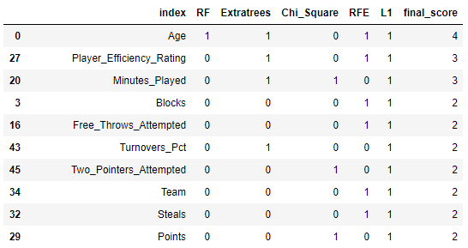
Feature Selection: Part 1 – Algorithmic Ranking
Algorithms Used
Random Forest
Extratrees
Chi Square
RFE
Lasso Regression (L1)
Combining the output of the algorithms led to a list of features with the highest prediction scores
Result

Slide 4
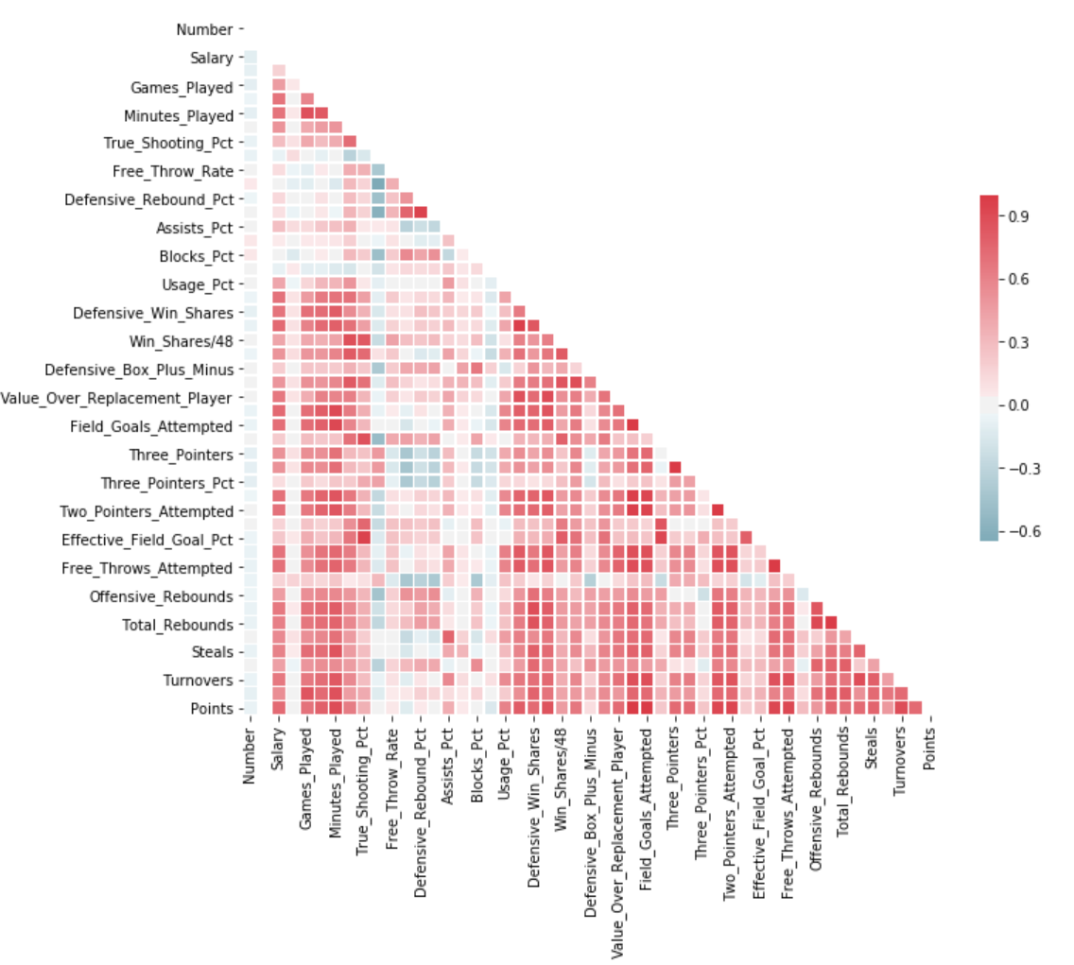
Feature Selection: Part 2 – Correlation Test
Correlation Heatmap
Process
Correlation heatmap was created
Remove obvious correlation (ex. three pointers and three pointer percent)
Strategically remove any other correlation greater than 0.9
*Some variables not displayed due to graph size constraints

Slide 5
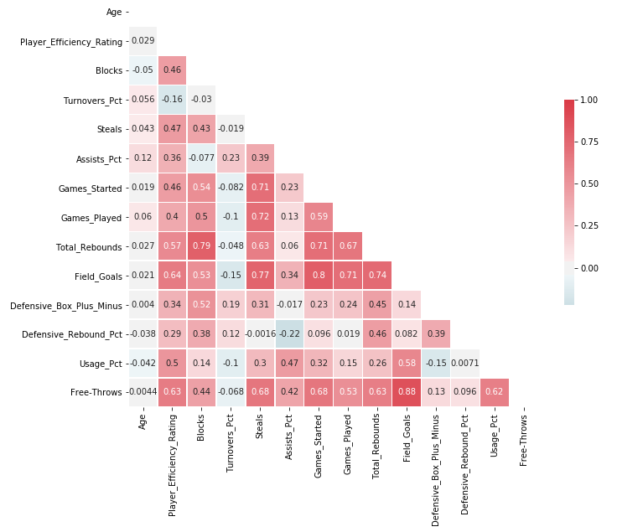
Feature Selection: Final Result
Selected Variables: 14
The number of features were reduced from 52 to 14.
This will reduce the time and storage required to run our models.
Reduction of multi-collinearity may improve our ability to interpret results
*Some variables not displayed due to graph size constraints

Slide 6

Model 1: Ordinary Least Squares (OLS)
Approach
Results
Our assumption was that there was a linear relationship between our features and the player salary
The OLS model is one of the simplest predictive models and was a good place to start with our data
The OLS method works by minimizing the sum of squares of the residuals
Model | Train RMSE | Train R² | Test RMSE | Test R²
OLS | 4398500 | 0.63 | 5024129 | 0.57
The R² values for the models indicate that we are able to account for about 60% of the salary prediction variability with the features we selected.
The RMSE values will serve as a reference point for the other linear models we are going to use.
Source: Singh, D. (2019, May 17). Deepika Singh. Retrieved from https://www.pluralsight.com/guides/linear-lasso-ridge-regression-scikit-learn

Slide 7
Model 2: Ridge Regression (RR)
Approach
Results
Ridge regression is an extension of linear regression where the loss function is modified to minimize the complexity of the model.
This modification is done by adding a penalty parameter that is equivalent to the square of the magnitude of the coefficients.
Loss function = OLS + α* summation (squared coefficient values)
In the above loss function, α is the parameter we need to select. A low α value can lead to over-fitting, whereas a high α value can lead to under-fitting.
We will look at different values for α
Model | Train RMSE | Train R² | Test RMSE | Test R²
RR, α=0.01 | 4398504 | 0.63 | 5024400 | 0.57
RR, α=10 | 4608385 | 0.59 | 5203120 | 0.54
The R² values for the models indicate that we are able to account for about 60% of the salary prediction variability with the features we selected.
The RMSE values for the RR method are slightly higher than the OLS values. This indicates that the OLS predictions are more accurate.
Increasing the α value decreased the model accuracy.
Source: Singh, D. (2019, May 17). Deepika Singh. Retrieved from https://www.pluralsight.com/guides/linear-lasso-ridge-regression-scikit-learn

Slide 8
Model 3: Lasso Regression (LR)
Approach
Results
Lasso regression is also a modification of linear regression. In Lasso, the loss function is modified to minimize the complexity of the model by limiting the sum of the absolute values of the model coefficients.
Loss function = OLS + α* summation (absolute values of the magnitude of the coefficients)
In the above loss function, α is the penalty parameter we need to select.
We will look at different values for α
Model | Train RMSE | Train R² | Test RMSE | Test R²
LR, α=0.01 | 4398500 | 0.63 | 5024129 | 0.57
LR, α=100 | 4398502 | 0.63 | 5023978 | 0.57
The R² values for the models indicate that we are able to account for about 60% of the salary prediction variability with the features we selected.
The RMSE values for the LR method are essentially identical to the OLS values. This indicates that the OLS and Lasso predictions are basically the same.
Increasing the α value had little impact on the model accuracy.
Source: Singh, D. (2019, May 17). Deepika Singh. Retrieved from https://www.pluralsight.com/guides/linear-lasso-ridge-regression-scikit-learn

Slide 9
Model 4: ElasticNet Regression (ENR)
Approach
Results
ElasticNet combines the properties of both Ridge and Lasso regression.
Loss function = OLS + α* summation (absolute values of the magnitude of the coefficients) + α* summation (squared coefficient values
In the above loss function, α is the penalty parameter we need to select.
We will look at different values for α
Model | Train RMSE | Train R² | Test RMSE | Test R²
ENR, α=0.01 | 4432638 | 0.62 | 5070003 | 0.56
ENR, α=10 | 7010747 | 0.06 | 7488845 | 0.05
The R² values for the models were still around 60%, but were slightly lower that what we saw with the other models.
The RMSE values for the ENR method were the highest of all the models. This indicates the least accurate prediction model. This is likely due to the fact that we removed features that were highly correlated with one another.
Increasing the α value had a negative impact on our prediction accuracy.
Source: Singh, D. (2019, May 17). Deepika Singh. Retrieved from https://www.pluralsight.com/guides/linear-lasso-ridge-regression-scikit-learn

Slide 10
Model 5: Extreme Gradient Boosting Regression (XGBR)
Approach
Results
XGBR is an ensemble modeling technique where new models are added to correct the errors made by existing models.
The method uses the gradient boosting decision tree algorithm.
Gradient boosting is an approach where new models are created that predict the residuals or errors of prior models and then added together to make the final prediction.
Model | Train RMSE | Train R² | Test RMSE | Test R²
XGBR | 1818766 | 0.92 | 4531190 | 0.65
The R² values for the XGBR method were the best of all models evaluated. Our training set R² had a value of 92%, which is excellent. The results diminished to only 65% when applied to the test set, but this about 10% better than our other models.
The RMSE values for the XGBR method were also the lowest of all models evaluated. This indicates the most accurate prediction model.
Source: Brownlee, J. (2019, August 21). A Gentle Introduction to XGBoost for Applied Machine Learning. Retrieved from https://machinelearningmastery.com/gentle-introduction-xgboost-applied-machine-learning/

Slide 11
Challenges
Feature Selection
Model Selection
Many methods giving different suggestions
High correlation across all features
Relatively high feature count, even after feature selection
We had to work with and learn to use models that we have never dealt with before
We tried (and failed) with several models outside of the ones listed. For example, we created a couple of Random Forests with poor results

Slide 12
Future Plans
Decide on the final model we will use
Make a comparison plot of predicted salaries vs actual salaries
Add the player names back to the dataframe so that we can see which players are overpaid and which ones are underpaid
Draft the dialogue we will use for the final presentation

